Slide 1
Lecture 5: Representation Learning
Kai-Wei Chang
CS @ UCLA
kw@kwchang.net
Couse webpage: https://uclanlp.github.io/CS269-17/

Slide 2
This lecture
Review: Neural Network
Recurrent NN
Representation learning in NLP

Slide 3
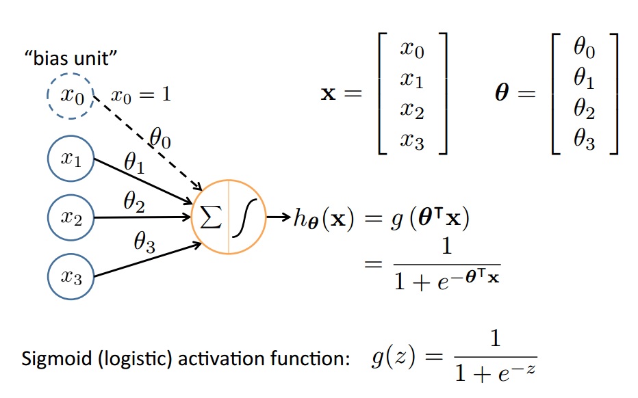
Neural Network
Based on slide by Andrew Ng
10

Slide 4
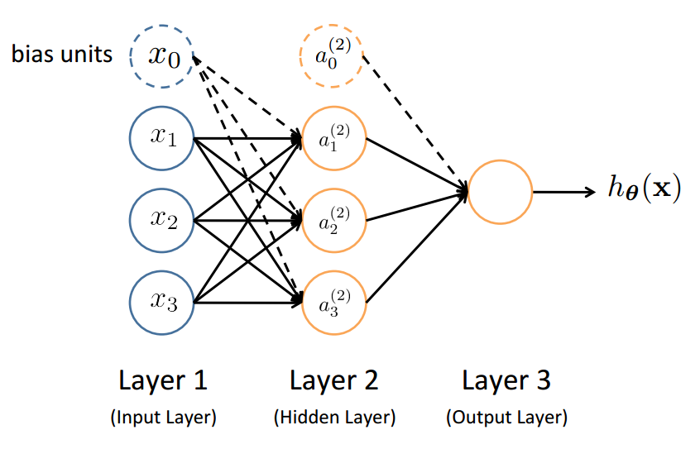
Neural Network (feed forward)
Slide by Andrew Ng
12

Slide 5
Feed-Forward Process
Input layer units are features (in NLP, e.g., words)
Usually, one-hot vector or word embedding
Working forward through the network, the input function is applied to compute the input value
E.g., weighted sum of the input
The activation function transforms this input function into a ﬁnal value
Typically a nonlinear function (e.g, sigmoid)
Based on slide by T. Finin, M. desJardins, L Getoor, R. Par
13

Slide 6
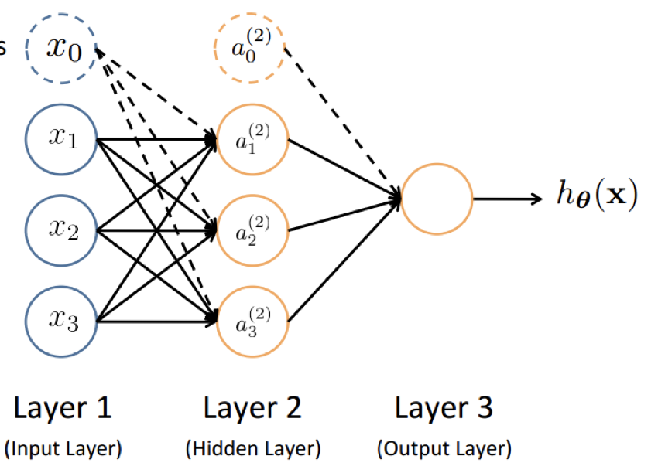
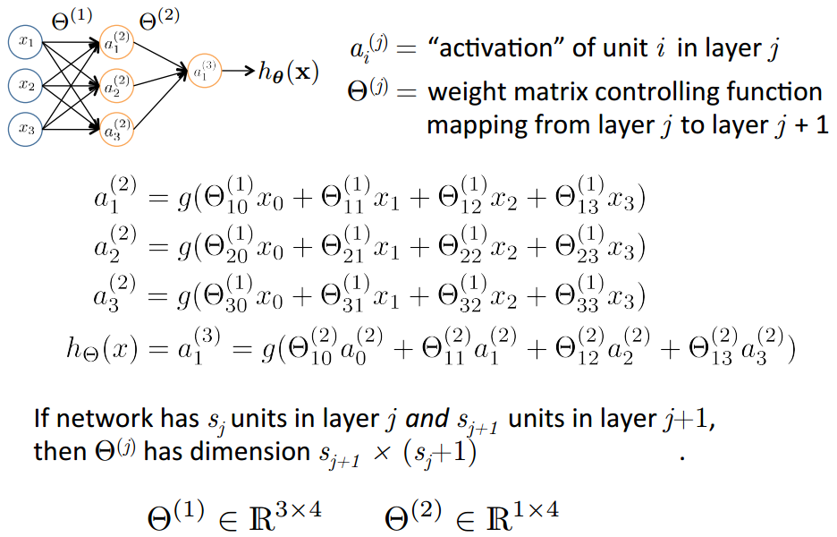
Slide by Andrew Ng
14

Slide 7
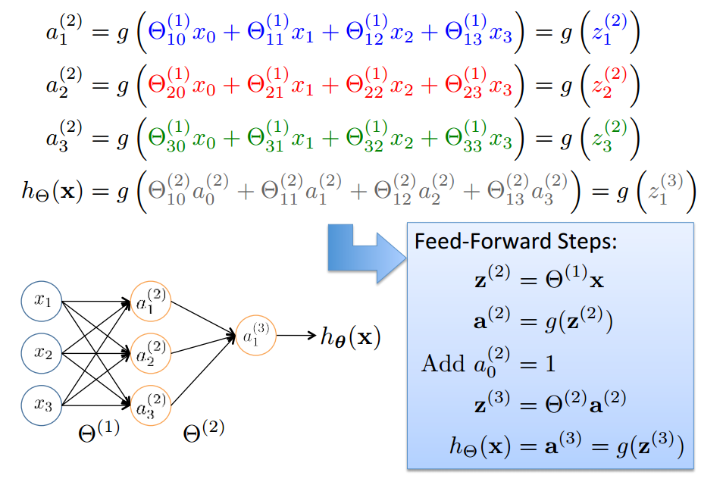
Vector Representation
Based on slide by Andrew Ng
15

Slide 8
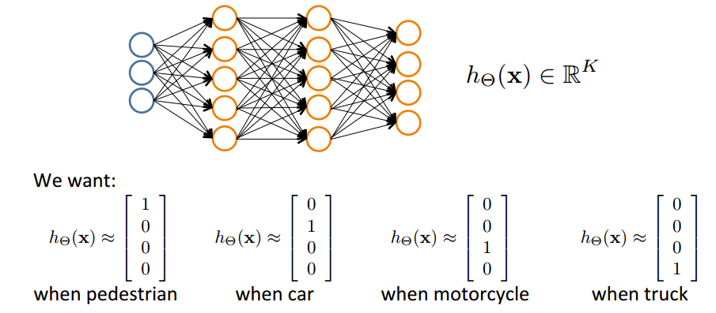
Can extend to multi-class
Pedestrian
Car
Motorcycle
Truck
Slide by Andrew Ng
17

Slide 9
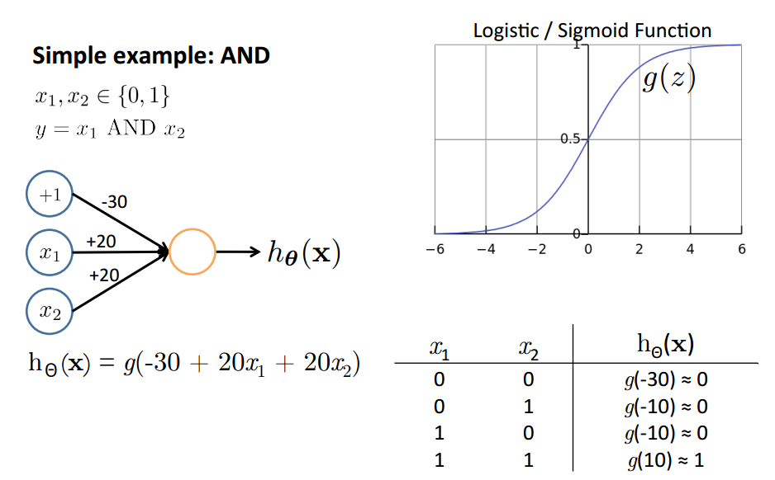
Why staged predictions?
Based on slide and example by Andrew Ng
21

Slide 10
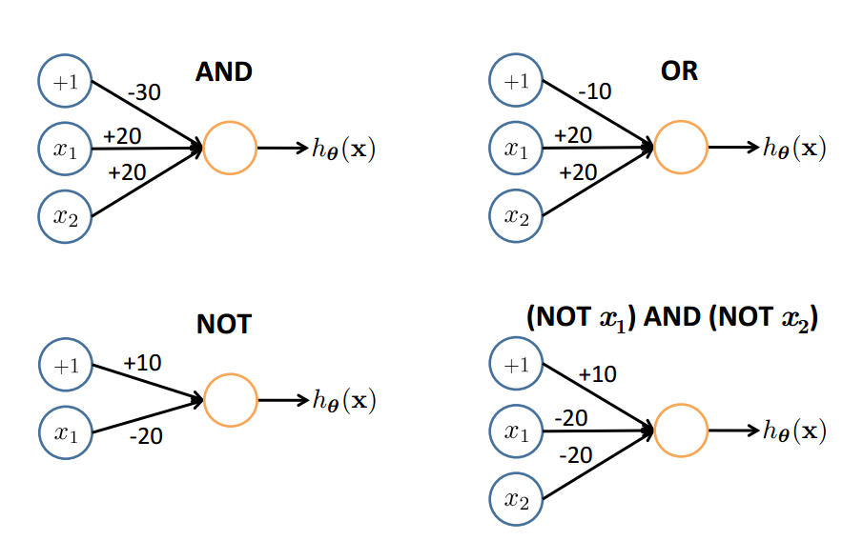
Representing Boolean Functions
22

Slide 11
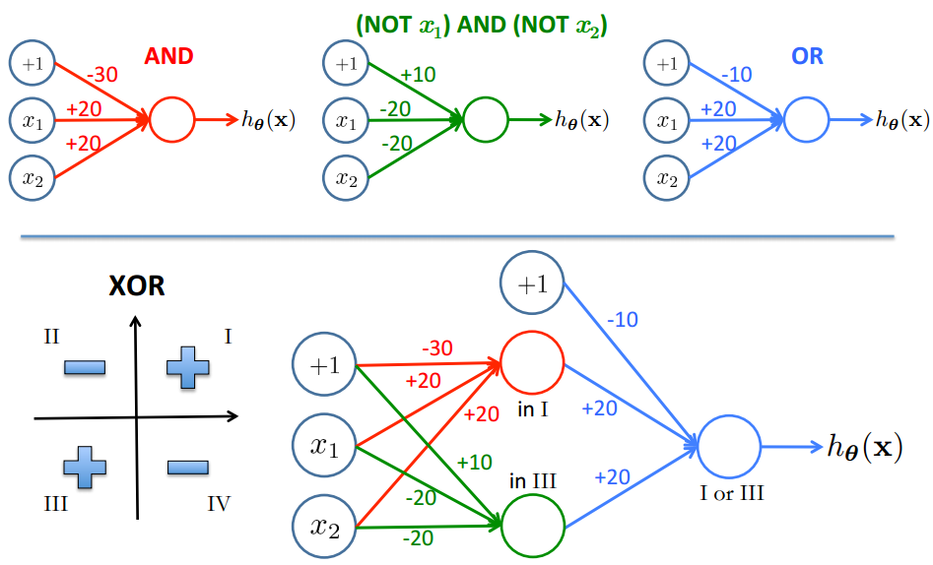
Combining Representations to Create Non-­Linear Functions
Based on example by Andrew Ng
23

Slide 12
Layering Representations
x₁ ... x₂₀
x₂₁ ... x₄₀
x₄₁ ... x₆₀
...
^{x}381 ^{... x}400
20 × 20 pixel images
d = 400 10 classes
Each image is “unrolled” into a vector x of pixel intensities

Slide 13
Layering Representations
x₁
x₂
x₃
x₄ x₅
Output Layer
“0”
“1”
“9”
x_{d}
Hidden Layer
Input Layer
Visualization of Hidden Layer

Slide 14
This lecture
Review: Neural Network
Learning NN
Recursive and Recurrent NN
Representation learning in NLP

Slide 15
Stochastic Sub-gradient Descent
Given a training set $𝒟=\{\left(x, y\right)\}$
Initialize $w←0∈ℝ^{n}$
For epoch $1…T$:
For $(x,y)$ in $𝒟$:
Update $w←w−η ∇ f(θ)$
Return $θ$

Slide 16
Recap: Logistic regression
$$\min_{θ} \frac{λ}{2n}θ^{T}θ+\frac{1}{n}\sum_{i}{\log{(}1+e^{−y_{i}{(θ}^{T}x_{i})})}$$
Let $h_{θ}(x_{i})=1/(1+e^{−θ^{T}x_{i}})$ (probability $y=1$ given $x_{i}$)
$\frac{λ}{2n}θ^{T}θ+\frac{1}{n}\sum_{i}{y_{i} log{(}h_{θ}(x_{i}))+(1−y_{i})( log{(1−}h_{θ}(x_{i}))}$

Slide 17
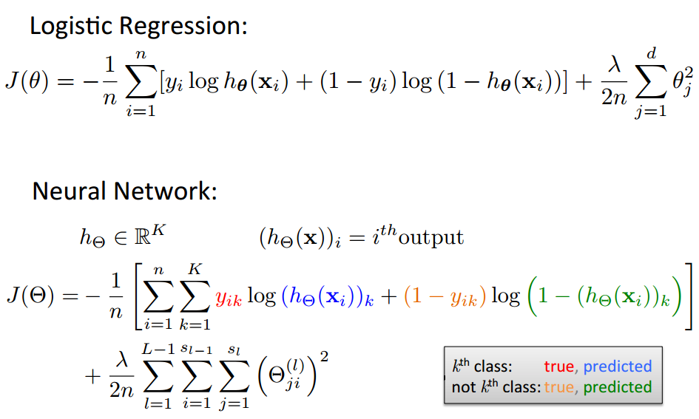
Cost Function
$$f\left(θ\right)=J\left(θ\right)+g\left(θ\right), g\left(θ\right)={γ θ}^{T}θ$$
Based on slide by Andrew Ng

Slide 18
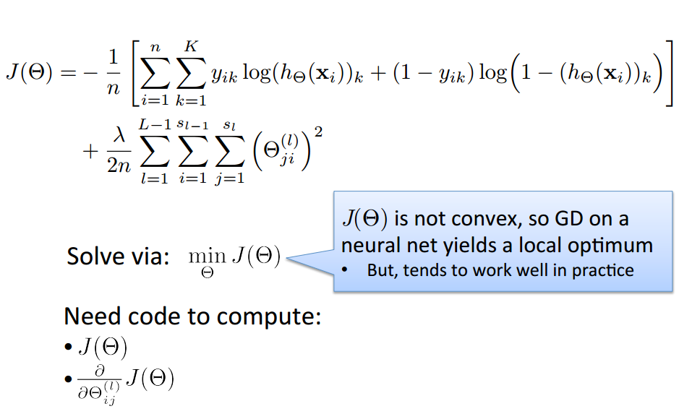
Optimizing the Neural Network
Based on slide by Andrew Ng

Slide 19
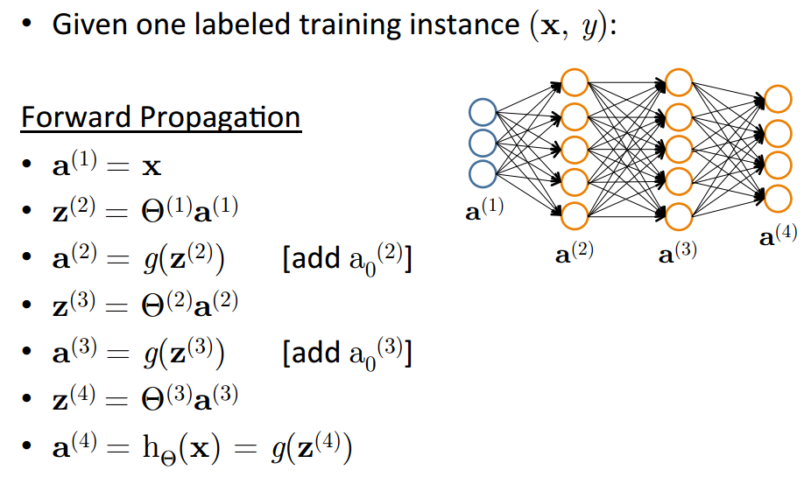
Forward Propagation
Based on slide by Andrew Ng

Slide 20
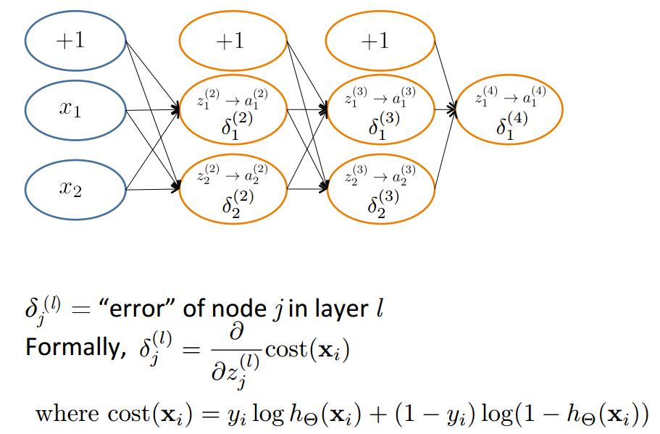
Backpropagation: Compute Gradient
Based on slide by Andrew Ng
36

Slide 21
This lecture
Review: Neural Network
Recurrent NN
Representation learning in NLP

Slide 22
How to deal with input with variant size?
Use same parameters
Today is a … </S>
<S> Today is … day

Slide 23
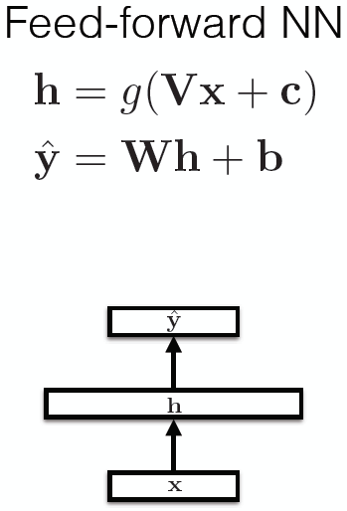
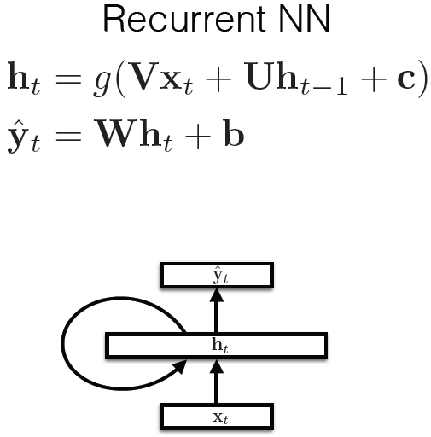
Recurrent Neural Networks

Slide 24
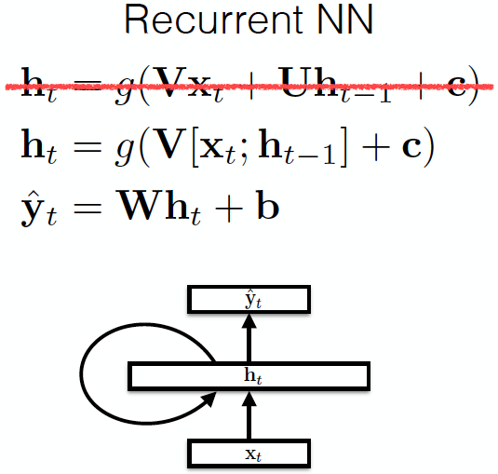
Recurrent Neural Networks

Slide 25
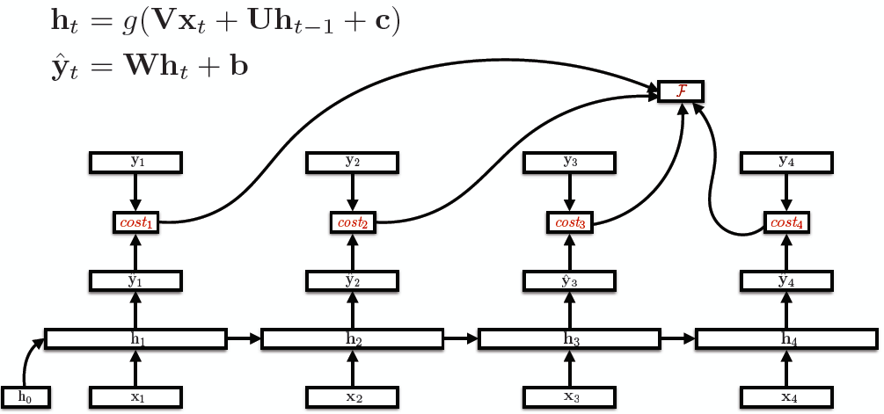
Unroll RNNs
U
V

Slide 26
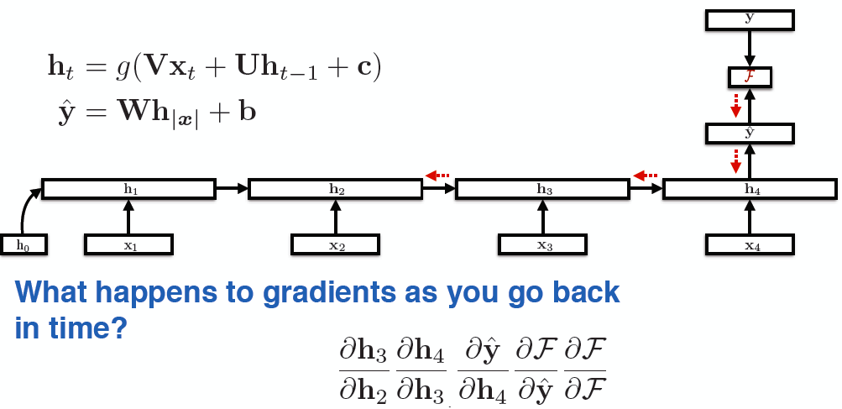
RNN training
Back-propagation over time

Slide 27
Vanishing Gradients
For the traditional activation functions, each gradient term has the value in range (-1, 1).
Multiplying n of these small numbers to compute gradients
The longer the sequence is, the more severe the problems are.

Slide 28
RNNs characteristics
Model hidden states (input) dependencies
Errors “back propagation over time”
Feature learning methods
Vanishing gradient problem: cannot model long-distant dependencies of the hidden states.

Slide 29
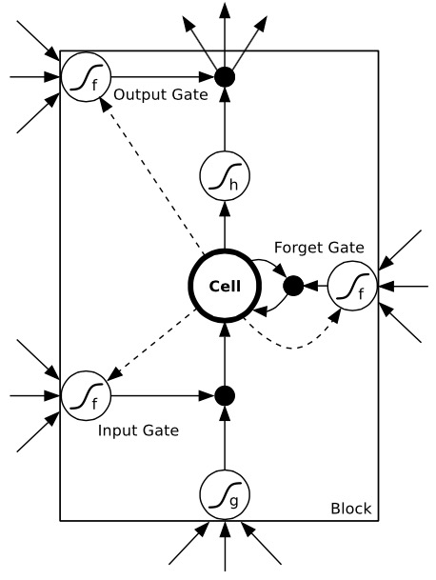
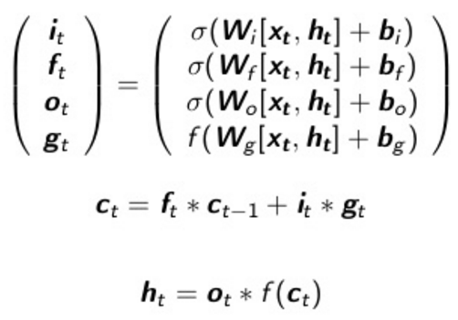
Long-Short Term Memory Networks (LSTMs)
Use gates to control the information to
be added from the input, forgot from the
previous memories, and outputted.
σ and f are sigmoid and tanh function
respectively, to map the value to [-1, 1]

Slide 30
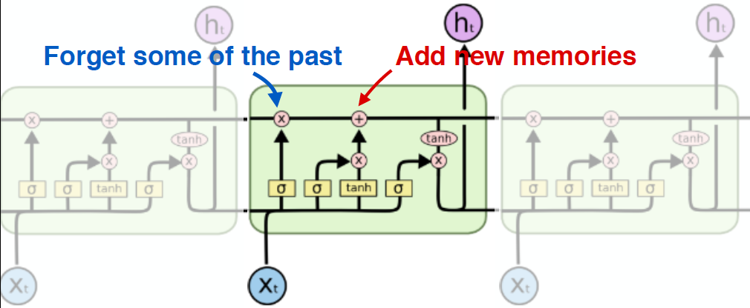
Another Visualization
Capable of modeling long-distant dependencies between states.
Figure credit: Christopher Olah

Slide 31
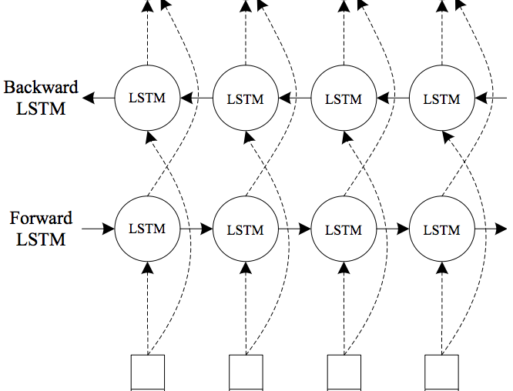
Bidirectional LSTMs

Slide 32
How to deal with sequence output?
Idea 1: combine DL with CRF
Idea 2: introduce structure in DL

Slide 33
LSTMs for Sequential Tagging
y_{t}
Sophisticated model of input + local predictions.

Slide 34
Recall CRFs for Sequential Tagging
Arbitrary features on the input side
Markov assumption on the output side

Slide 35
LSTMs for Sequential Tagging
Completely ignored the interdependencies of the outputs
Will this work? Yes.
Liang et. al. (2008), Structure Compilation: Trading Structure for Features
Is this the best model? Not necessarily.

Slide 36
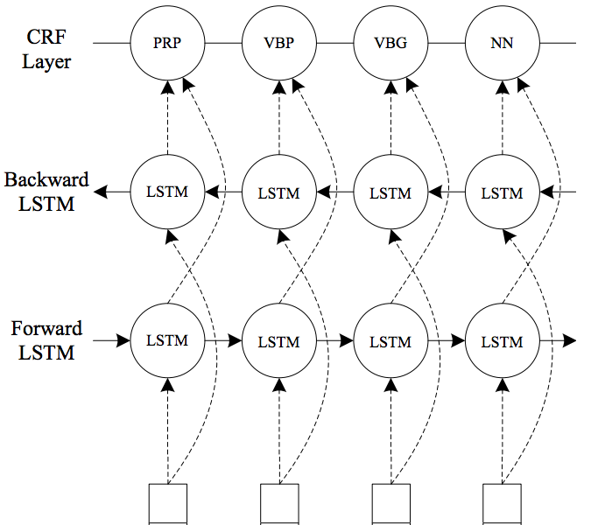
Combining CRFs with LSTMs

Slide 37
Traditional CRFs v.s. LSTM-CRFs
Traditional CRFs:
LSTM-CRFs:
where Ω is LSTM parameters

Slide 38
Combining Two Benefits
Directly model output dependencies by CRFs.
Powerful automatic feature learning using biLSTMs.
Jointly training all the parameters to “share the modeling responsibilities”

Slide 39
Transfer Learning with LSTM-CRFs
Neural networks as feature learner
Share the feature learner for different tasks
Jointly train the feature learners so that it learns the common features.
Use different CRFs for different tasks to encode task-specific information
Going forward, one can imagine using other graphical models besides linear chain CRFs.
Notes:
Ask students for brainstorming on ideas of combining graphical models with NNs.

Slide 40
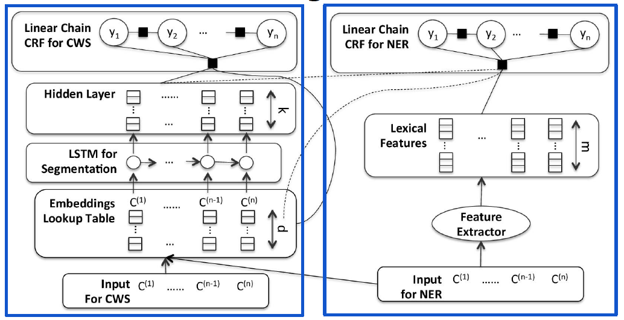
Transfer Learning CWS + NER
Shared

Slide 41
Joint Training
Simply linearly combine two objectives.
Alternative updates for each module’s parameters.

Slide 42
How to deal with sequence output?
Idea 1: combine DL with CRF
Idea 2: introduce structure in DL

Slide 43
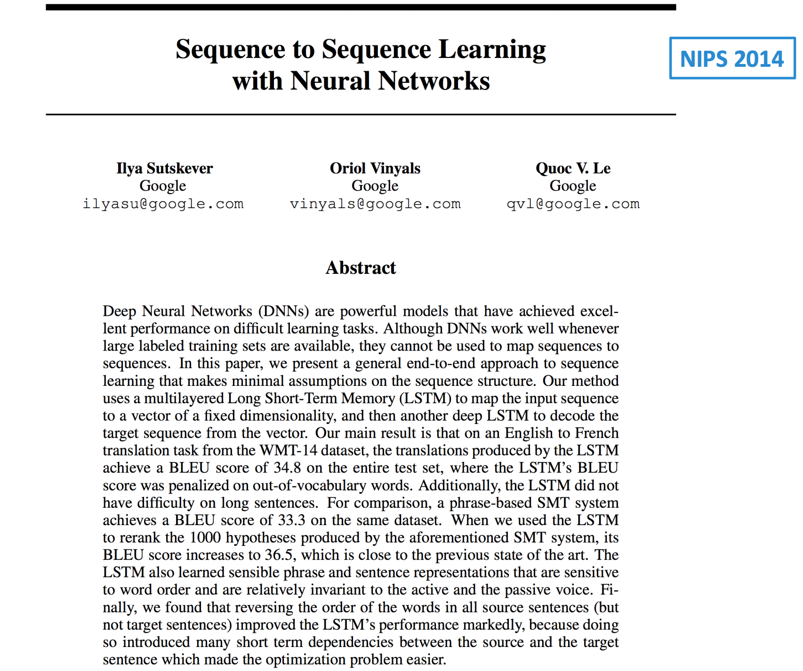

Slide 45
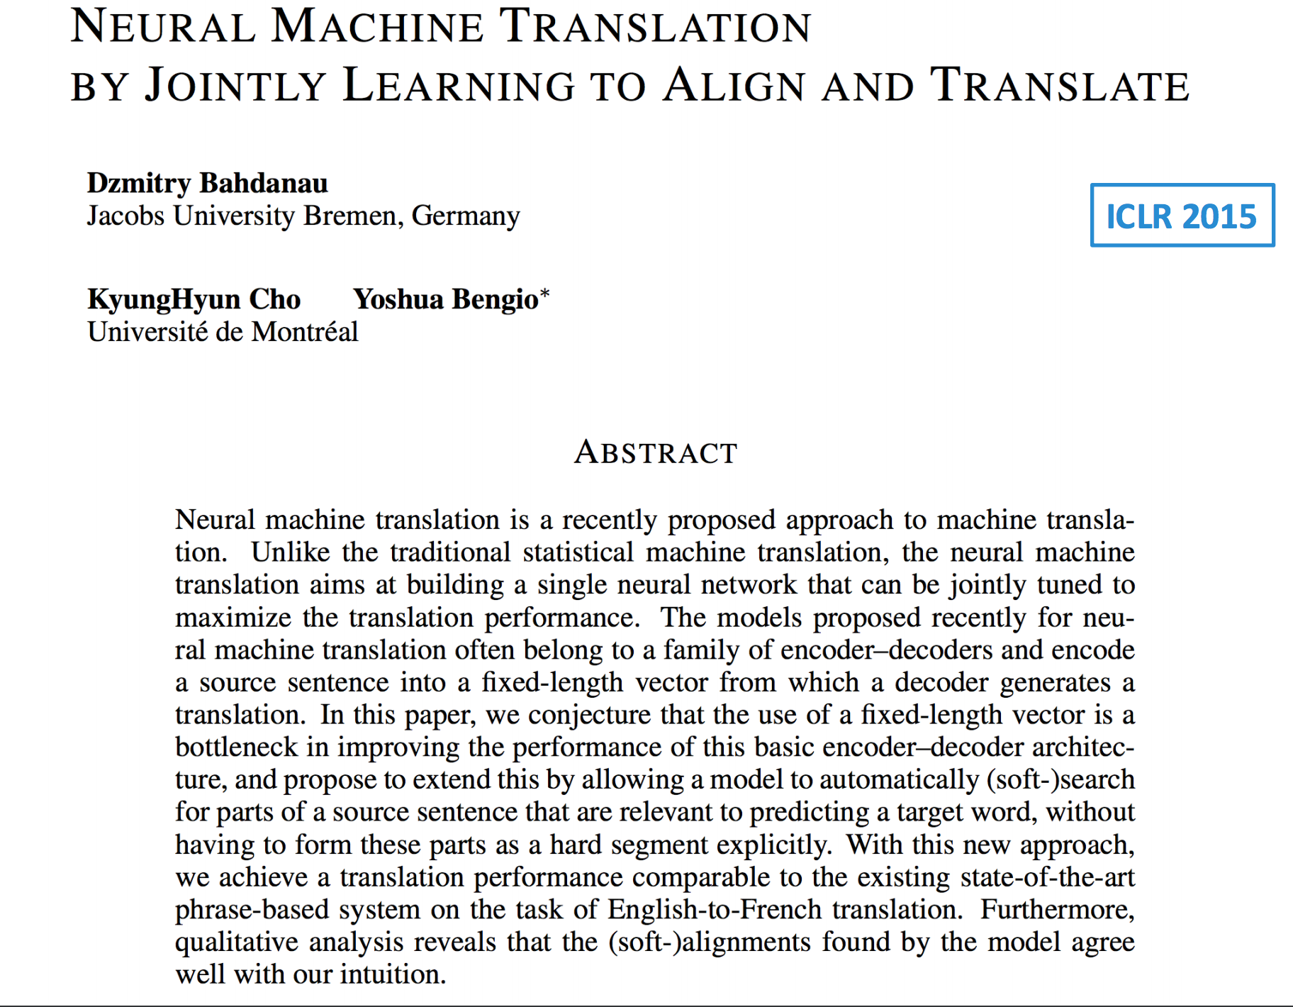

Slide 46
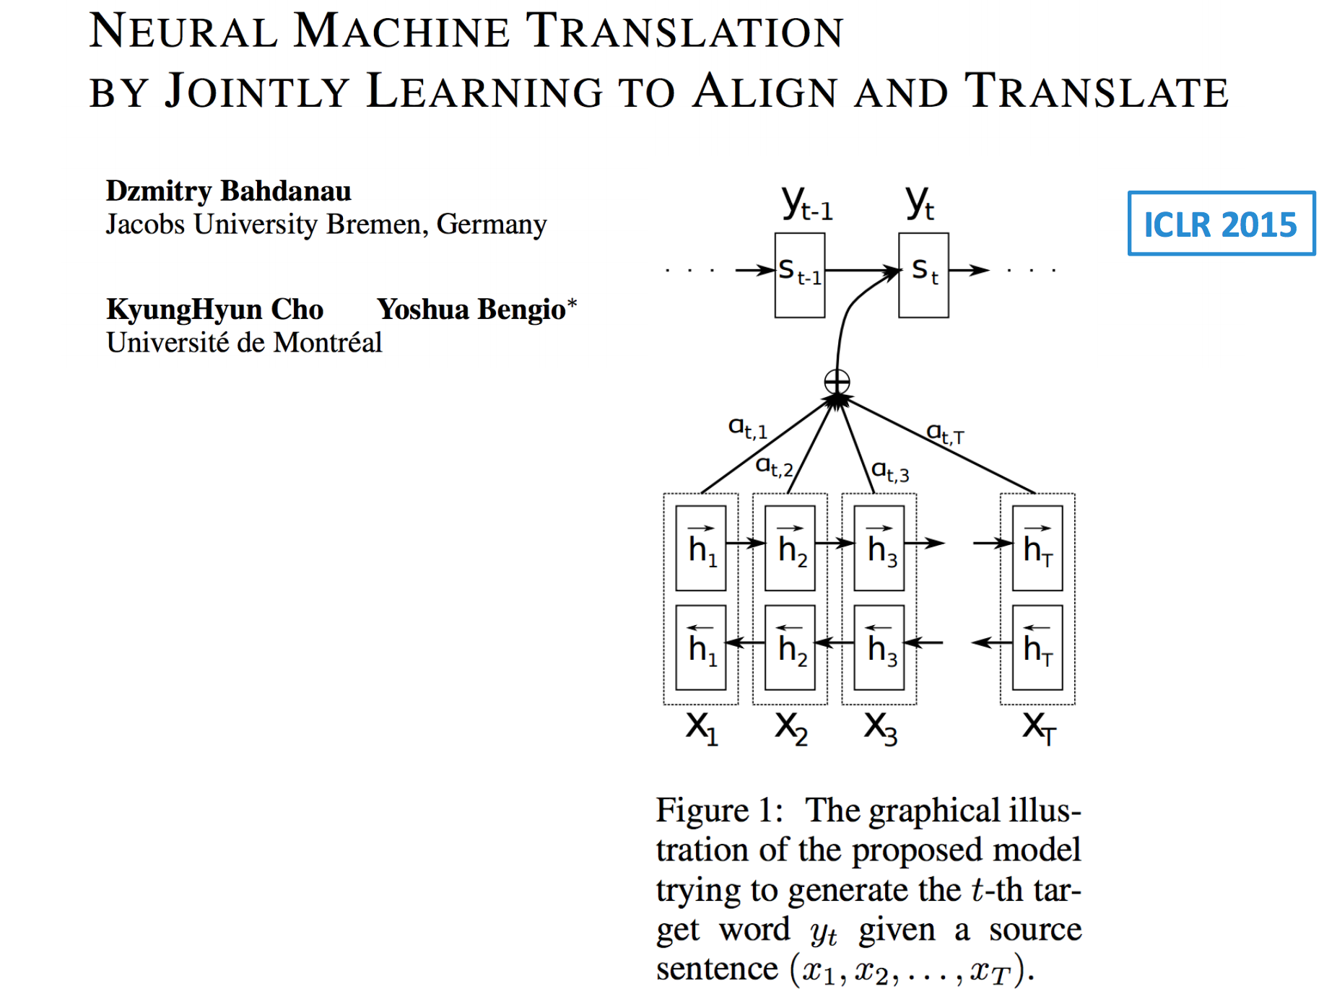

Slide 47
